Slide 1

Stacks
A library lending app, from commit to cluster
DevOps Final Capstone
Hemang · Enrollment 24bcs10209
Notes:
Introduce Stacks: a small library lending desk, and the DevOps pipeline around it.

Slide 2
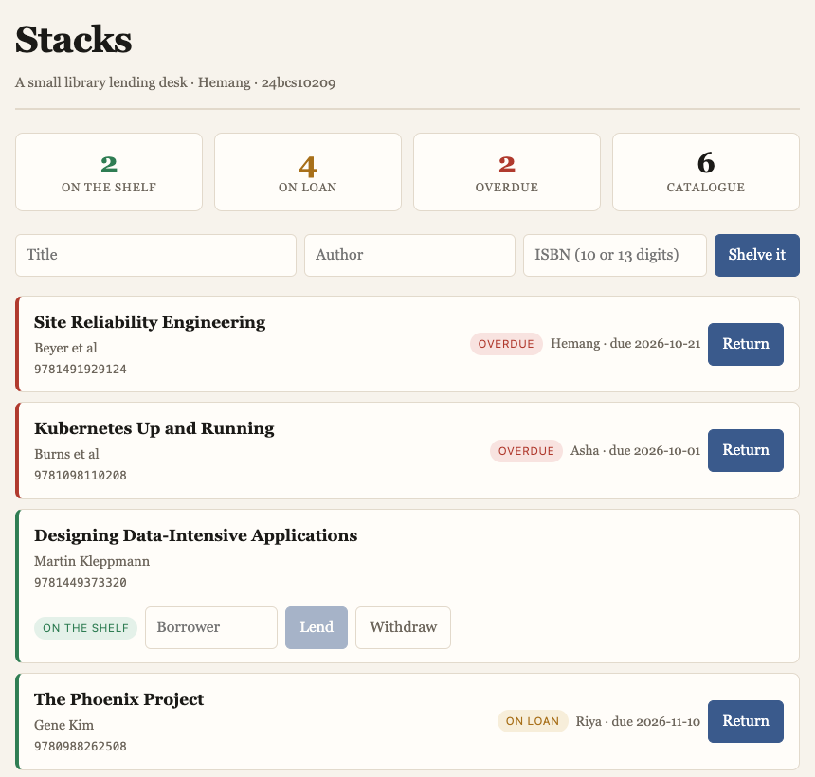
What I built
A catalogue of physical copies. Each copy is on the shelf or on loan, and a loan turns overdue on its own once the due date passes.
9
20
95%
API routes
pytest cases
coverage
A copy cannot be lent twice or withdrawn while out
Loans default to 14 days, configurable without a rebuild
"Overdue" is derived from the due date, never stored
Duplicate ISBNs blocked by a UNIQUE index, not only code
Notes:
The domain is deliberately my own, not the TaskBoard reference. The interesting rules are what you may not do.

Slide 3










Tech stack
Backend
Python 3.12, FastAPI, SQLAlchemy, Alembic
Frontend
React 18 + Vite, served by nginx
Database
PostgreSQL 16, SQLite in tests
Containers
Docker multi-stage, non-root, Compose
CI/CD
GitHub Actions, GHCR, SHA image tags
Security
Trivy, bandit, pip-audit, gitleaks
Infrastructure
Terraform, AWS VPC + EKS, LocalStack
Orchestration
Kubernetes, Helm 3, Ingress, HPA
GitOps
Argo CD, auto-sync with self-heal
Observability
Prometheus, Grafana

Slide 4
Architecture
Kubernetes · namespace stacks · synced by Argo CD
Ingress
nginx / and /api
Frontend
React · nginx · 2 pods
/
Browser
stacks.local
/api
Backend
FastAPI · 2–8 pods (HPA)
PostgreSQL 16
PVC-backed
Liveness /health never touches the DB. Readiness /ready does.
Prometheus
scrapes /metrics
Grafana
dashboards

Slide 5




From commit to cluster
1
2
3
4
5
6
Push
Test & scan
Build & push
Release gate
GitOps bump
Argo CD sync
git push to main
pytest, flake8, SAST, SCA, secrets
two images to GHCR, tagged by SHA
Trivy: no fixable HIGH/CRITICAL
CI commits the tag to values-gitops
rolls the pods to match Git
CI never runs kubectl. It writes one file in Git; Argo CD does the deploying. A rollback is a git revert.

Slide 6
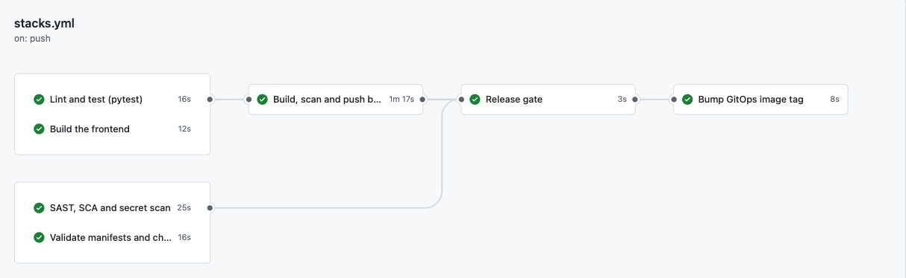
CI/CD: seven gated jobs
7 jobs
SHA tags
1m 55s
test, frontend, security and manifests run in parallel
image tag = 12-char commit SHA, never latest
push to deployable images, end to end

Slide 7



DevSecOps: four scanners, one gate
SAST
SCA
Secrets
Images
bandit
pip-audit
gitleaks
Trivy
our own source for insecure patterns
third-party dependencies with known CVEs
full Git history for committed credentials
both images, OS and library packages
The gate fails only on fixable HIGH or CRITICAL findings.
An unfixable CVE that blocks every build becomes a gate people route around. Both images also run as non-root users, set in the Dockerfile.

Slide 8
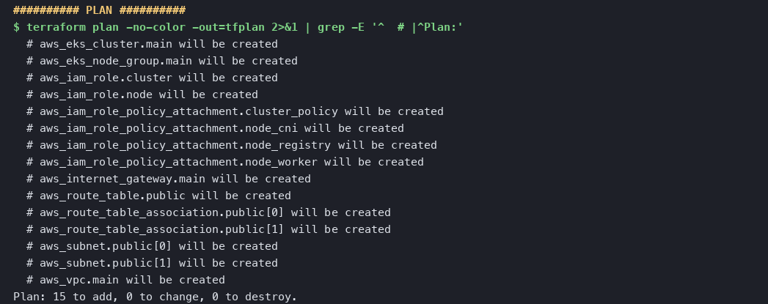

Infrastructure as code: Terraform
13 / 15
resources applied: VPC 10.30.0.0/16, two public subnets in two AZs, internet gateway, routes and IAM roles
terraform plan: 15 resources, VPC, subnets, routing, IAM and EKS
Stated plainly: no EKS cluster
Remote-state ready, terraform.tfvars.example only, and no credentials in Git
There is no AWS account behind this project. LocalStack's free tier returns HTTP 501 for CreateCluster, so the two EKS resources do not apply. minikube stands in for the cluster.

Slide 9
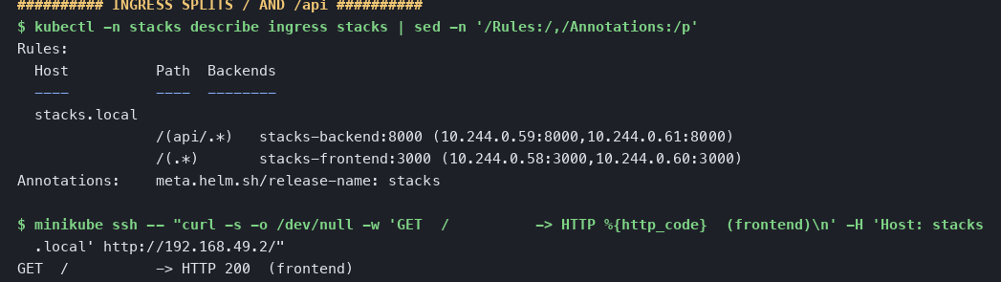


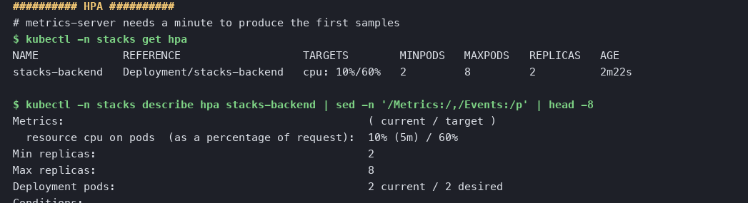


Kubernetes and Helm
One chart, three value sets
values.yaml, values-dev.yaml, values-prod.yaml; Postgres migrates in an init container
HPA: 2 to 8 pods
backend scales on 60% CPU, metrics-server supplies the samples
Ingress splits one host
/ goes to the React SPA, /api to the backend, no CORS
Data survives pods
Postgres on a PVC; deleting its pod keeps every loan

Slide 10
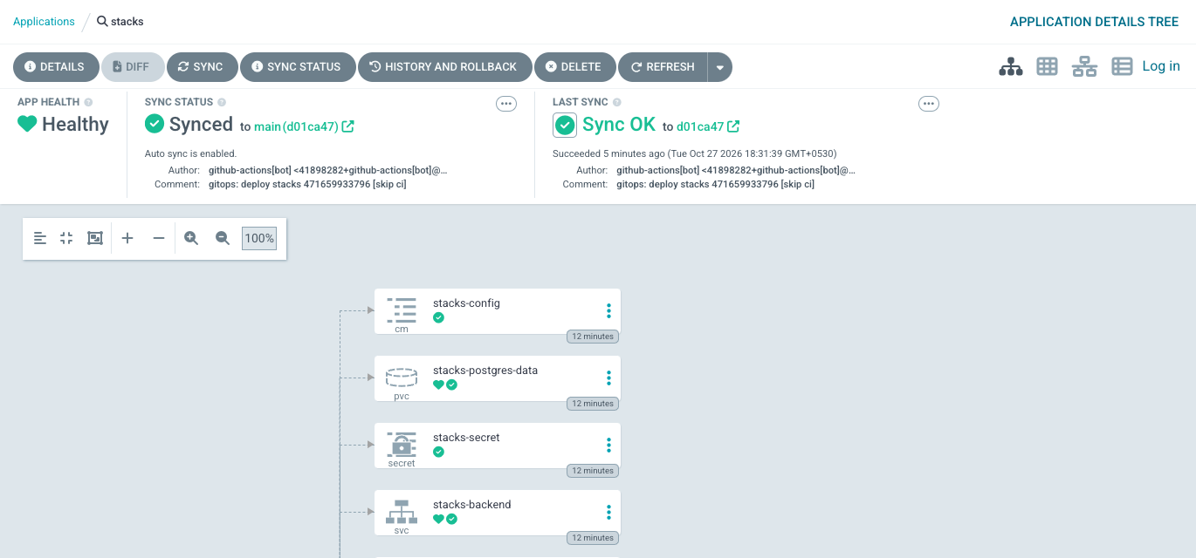
GitOps with Argo CD
Git is the source of truth
the Application renders helm/stacks from main
prune: true
deleted from Git, deleted from the cluster
selfHeal: true
a manual kubectl edit is reverted
[skip ci] on the bump
it moves the cluster, not the pipeline
Synced to the bot's commit d01ca47: "gitops: deploy stacks 471659933796"

Slide 11
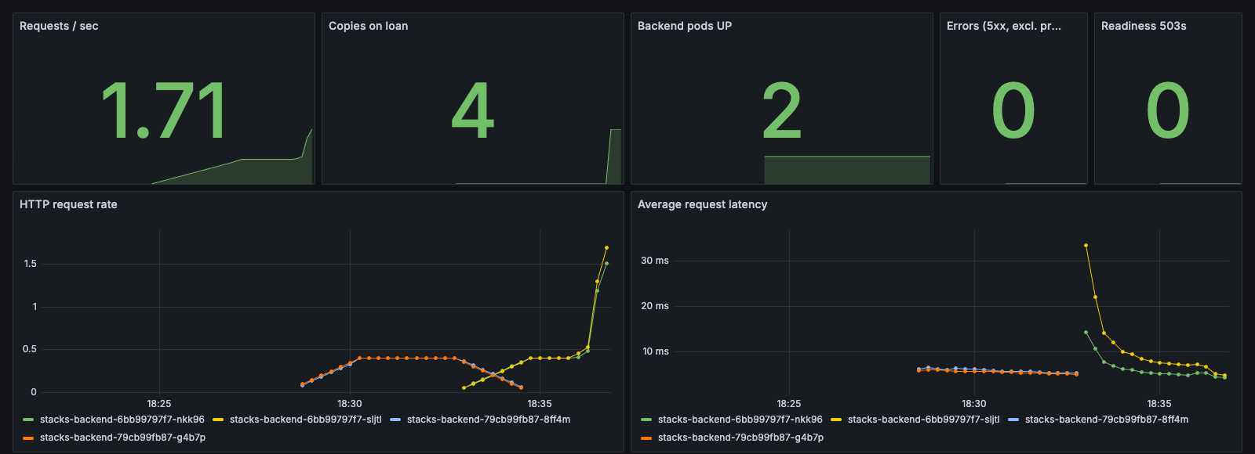
Observability: Prometheus and Grafana
stacks_http_requests_total
stacks_http_errors_total (5xx, probes excluded)
stacks_not_ready_total
stacks_books_total, stacks_books_overdue
Live dashboard during the Argo CD rollout: old pods hand over to new ones
Prometheus finds the pods itself. Kubernetes service discovery plus pod annotations means a new replica is scraped without editing any config. Both backend pods show as UP.

Slide 12
Key learnings
1
Derive what time decides
2
Put the constraint in the database
Storing OVERDUE would be wrong every midnight. Computing it from the due date cannot drift.
The handler's ISBN check is a nice message; the UNIQUE index is what prevents duplicates.
3
Route order is behaviour
4
A readiness 503 is not an error
/api/books/stats declared after /{id} parses as an id and returns 422. It needs a test.
Counting it as one turns every healthy rollout into an alert.

Slide 13
A commit is the only input
Tests, scans, the registry and the cluster all follow from it.
github.com/hemangtk/DevOps
Final DevOps Project/ · Hemang · 24bcs10209

